Slide 1
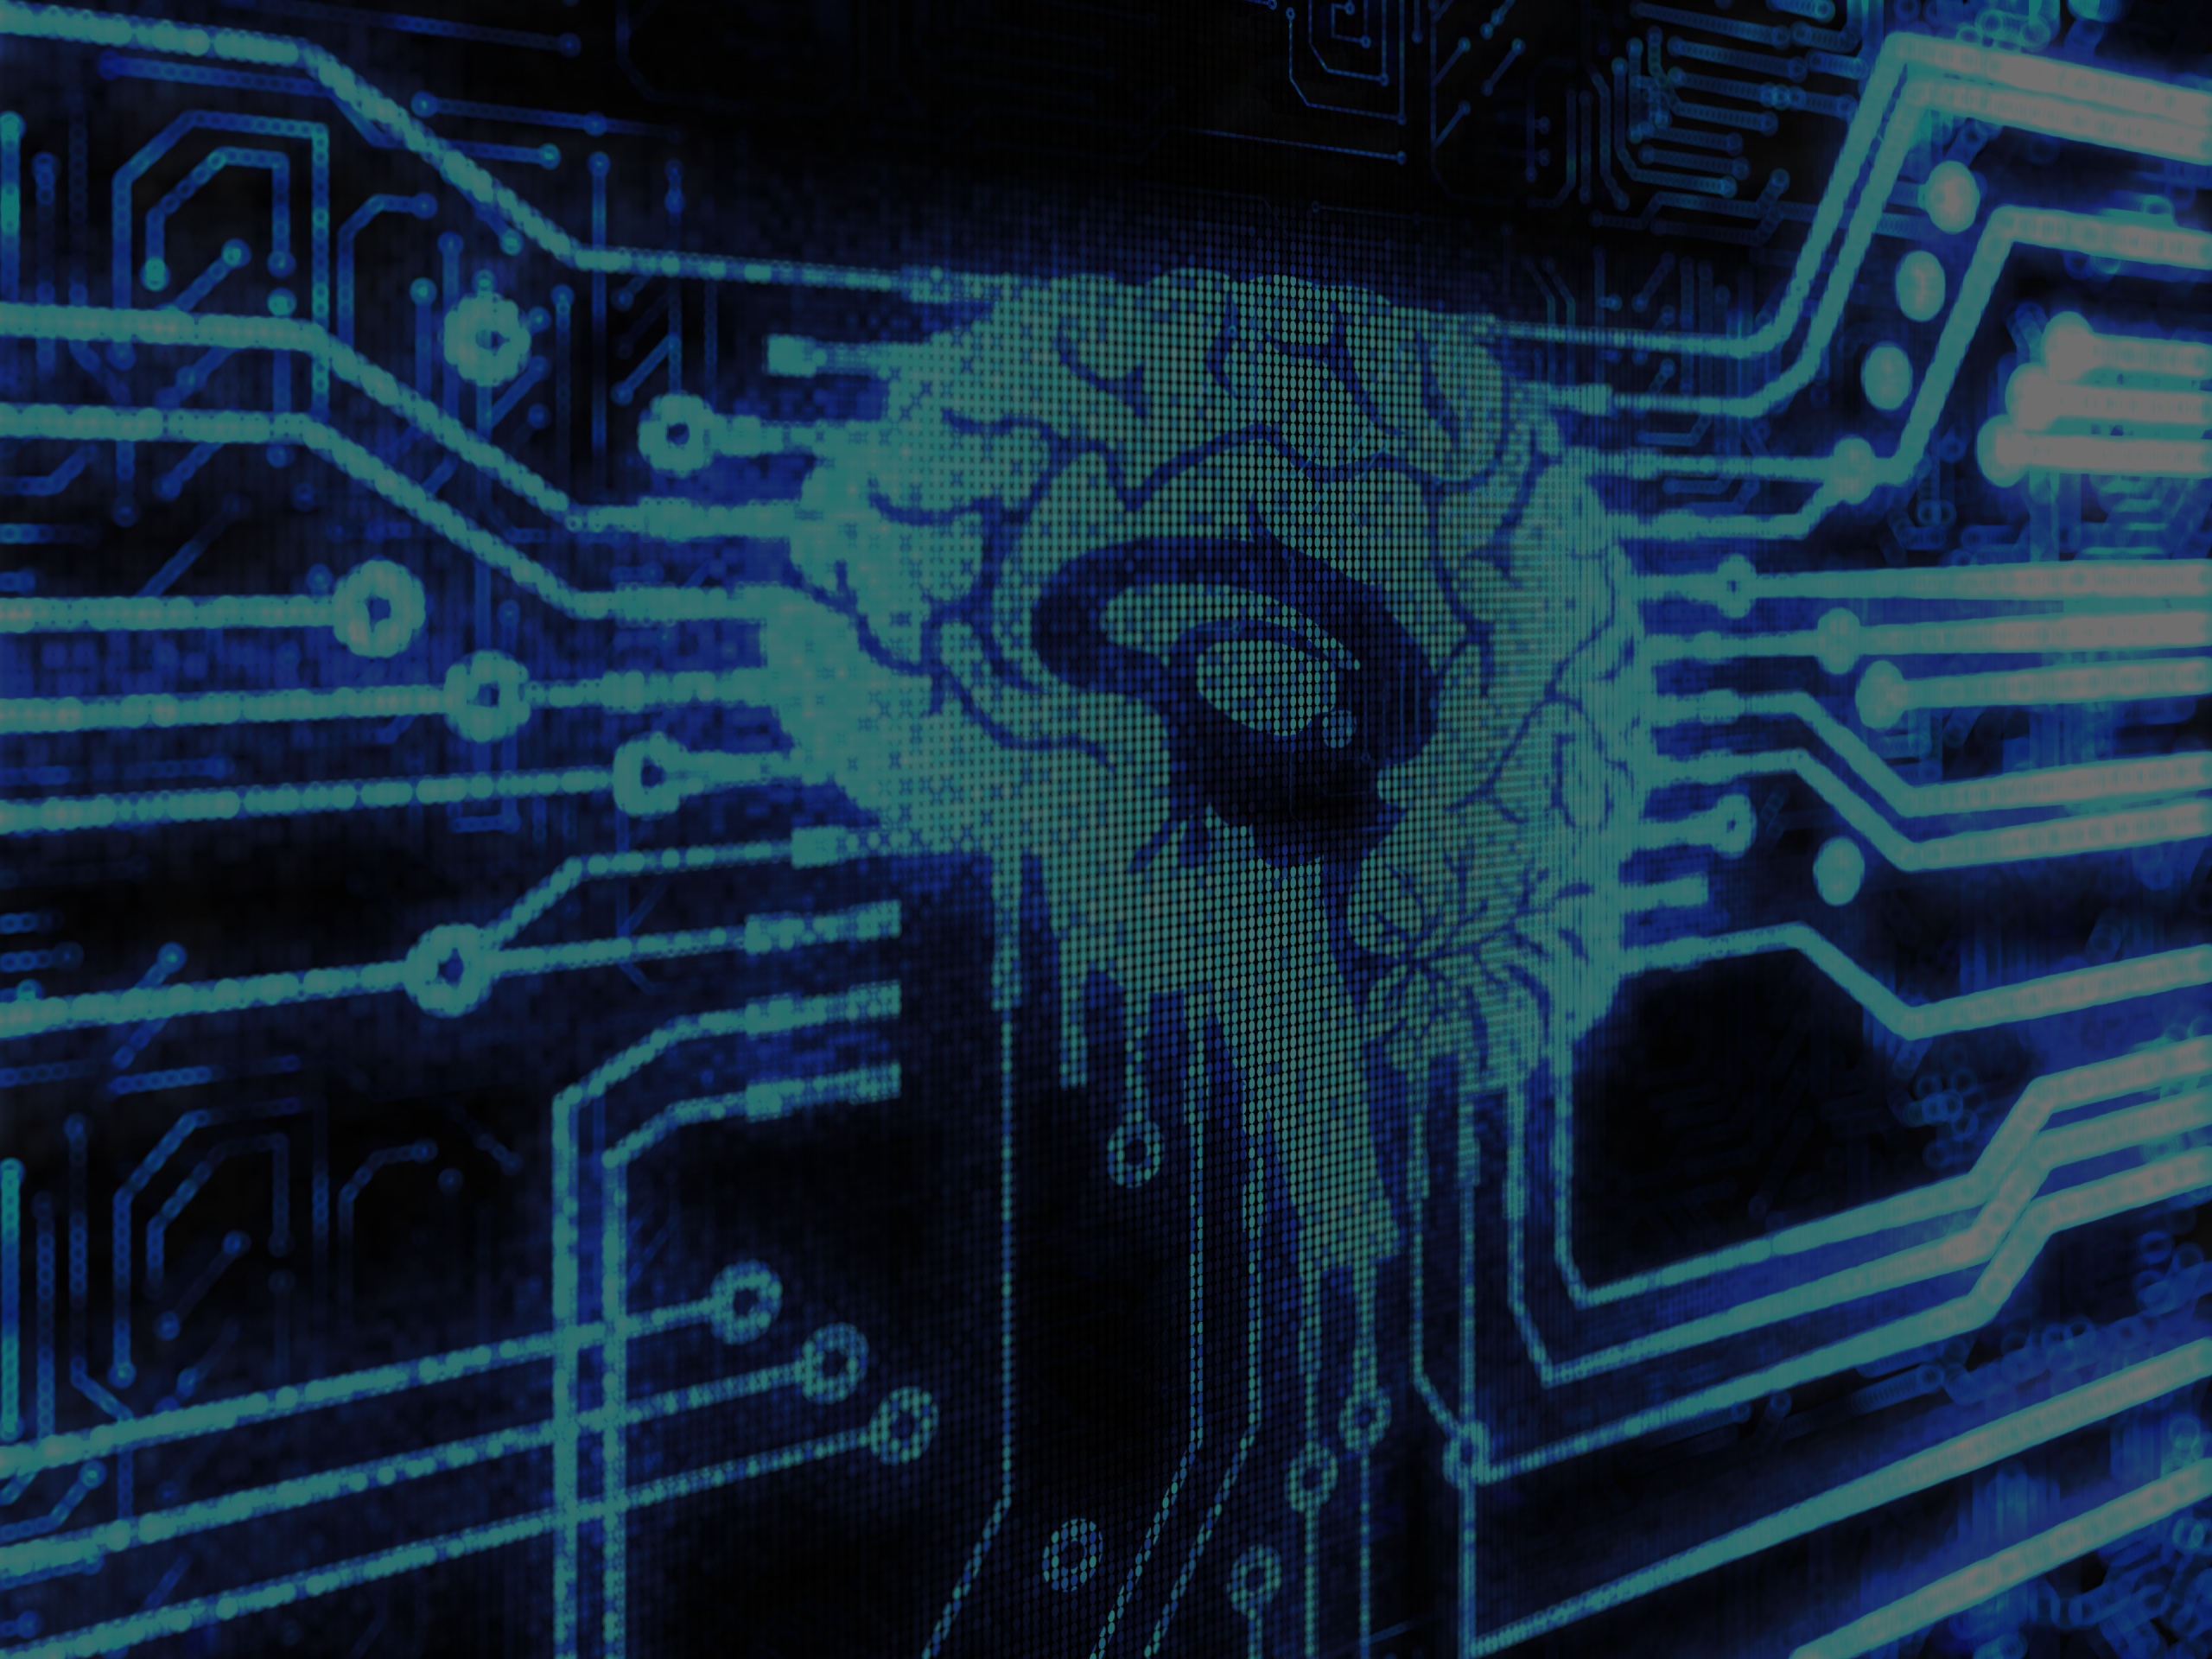
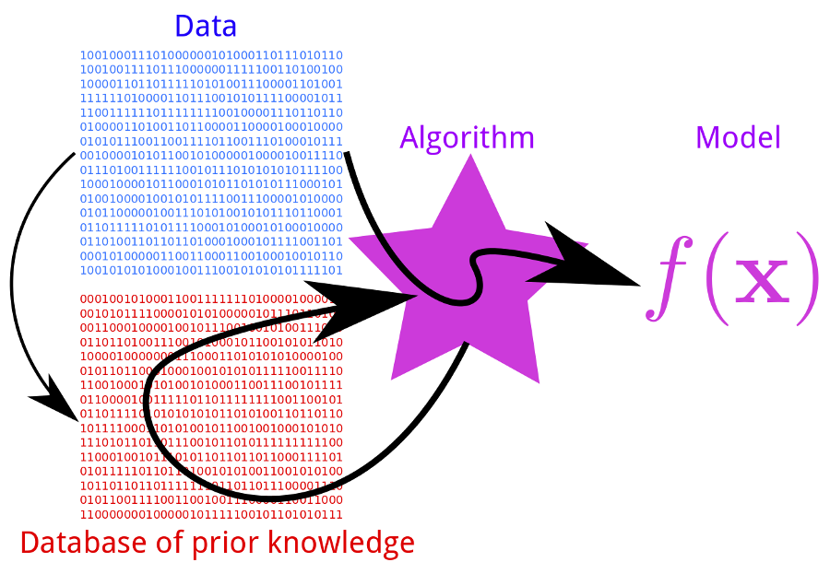
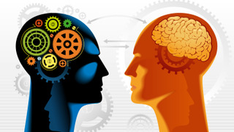
Chat-Bot with Machine Learning
A Chat-Bot which uses Machine Learning Algorithms to modify future behaviour based on past behaviour.
Features Include:
Persona integration, Memories of past conversations and user specific data like name, age, gender.
Pannous, the technology behind personal assistants like Siri.
User Specified Learning, invalid responses can be fixed immediately by the user. Simply tell the program what to say or do instead.
Open design allows for additional features, such as Text-To-Speech and Voice Recognition to be added with very little overheard.
User Input
Machine Learning
History
Applying The Model
User
Open the Cargo Bay Doors HAL
Chat-Bot
I Cannot Do That Dave
User
Incorrect Response
Open the Cargo Bay Doors
David Monahan
Opening the Cargo Bay Doors
Chat-Bot

